Slide 1
Beers & breweries
Reannan McDaniel & Jenna Ford
6/20/2019

Slide 2
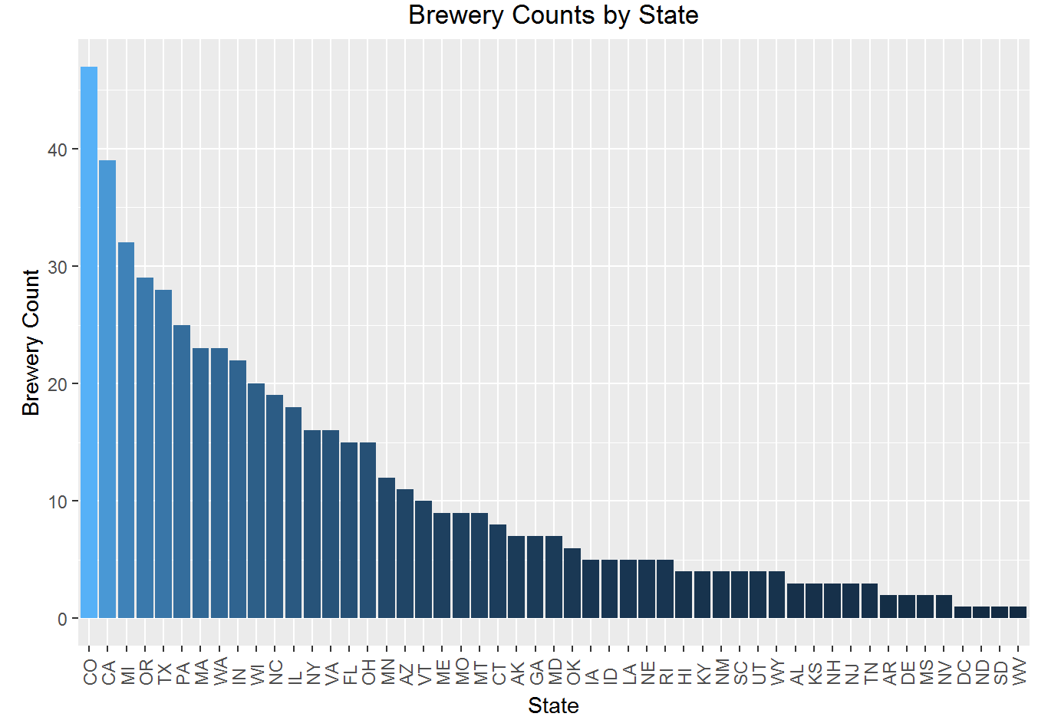
Breweries by state
Top 10 States:
Colorado
California
Michigan
Oregon
Texas
Pennsylvania
Massachusetts
Washington
Indiana
Wisconsin

Slide 3
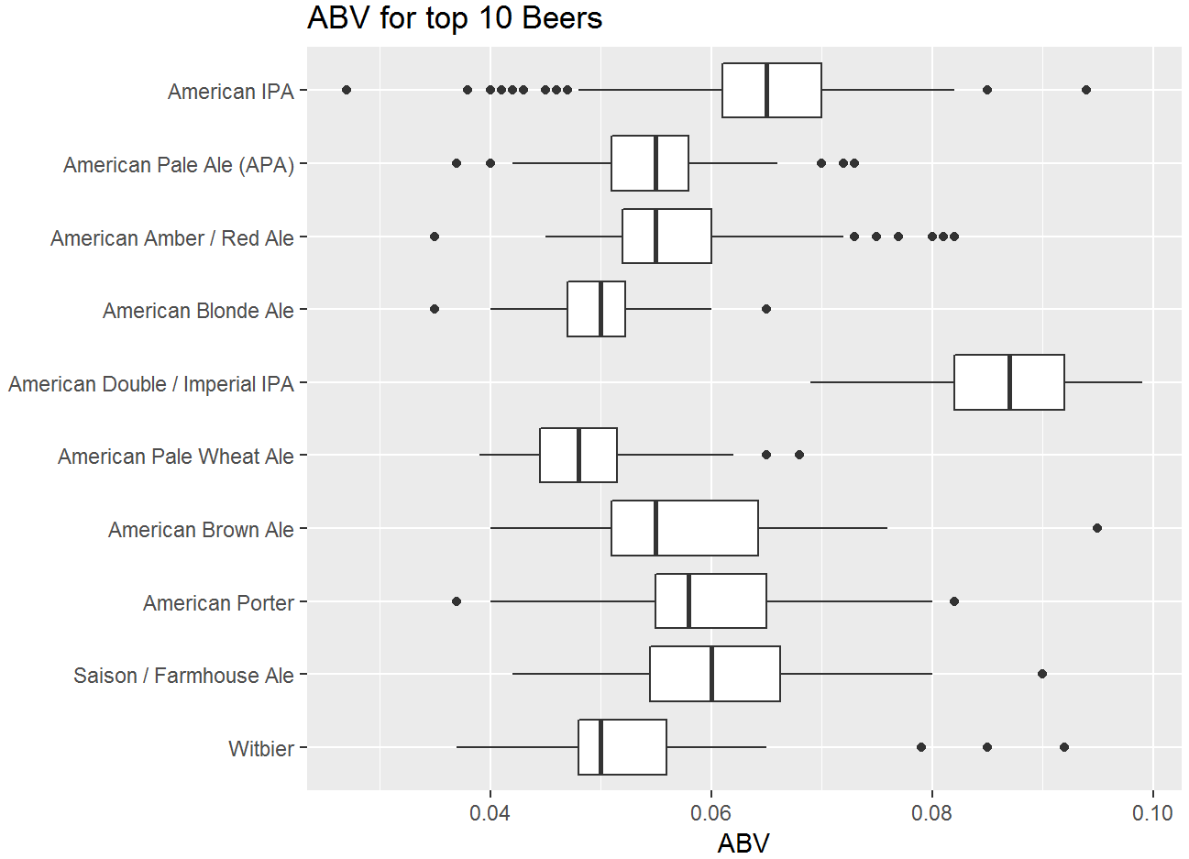
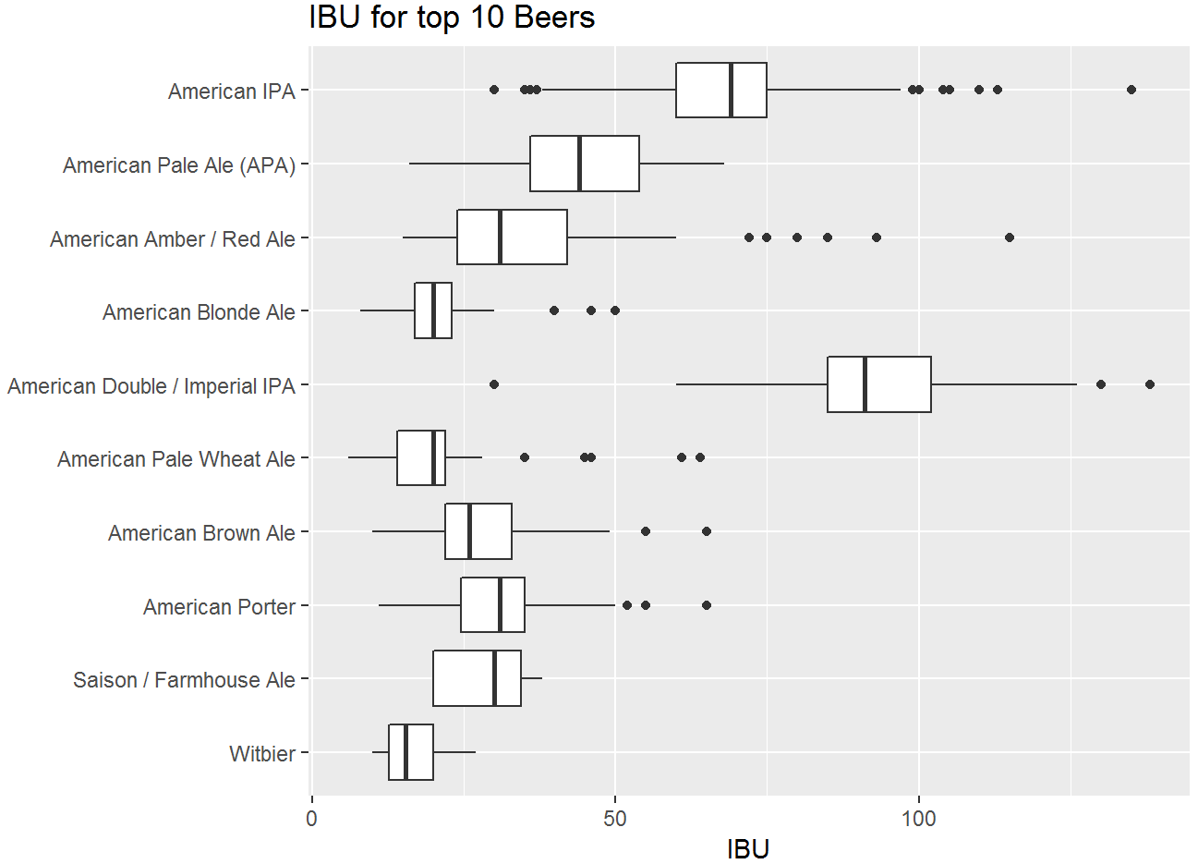
Top 10 Most Popular Beers ABV & IBU
Popularity is determined by the number of beers of each type being produced.

Slide 4
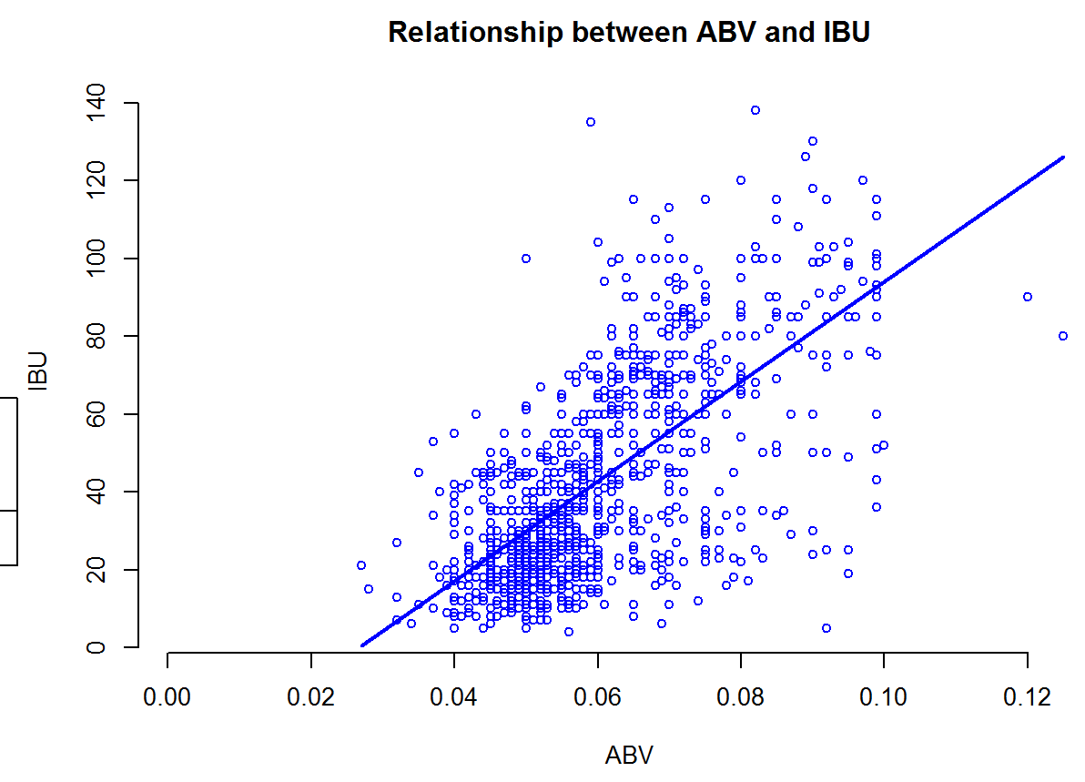
Relationship between abv & ibu

Slide 5
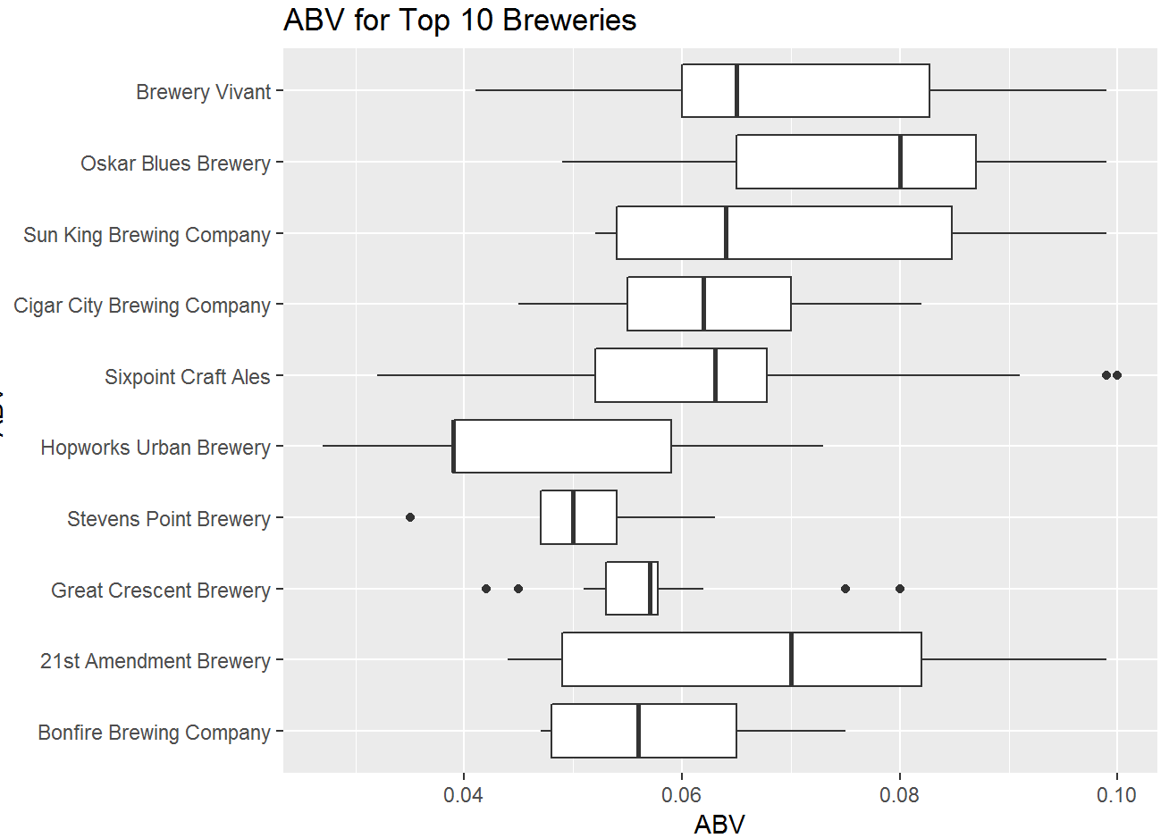
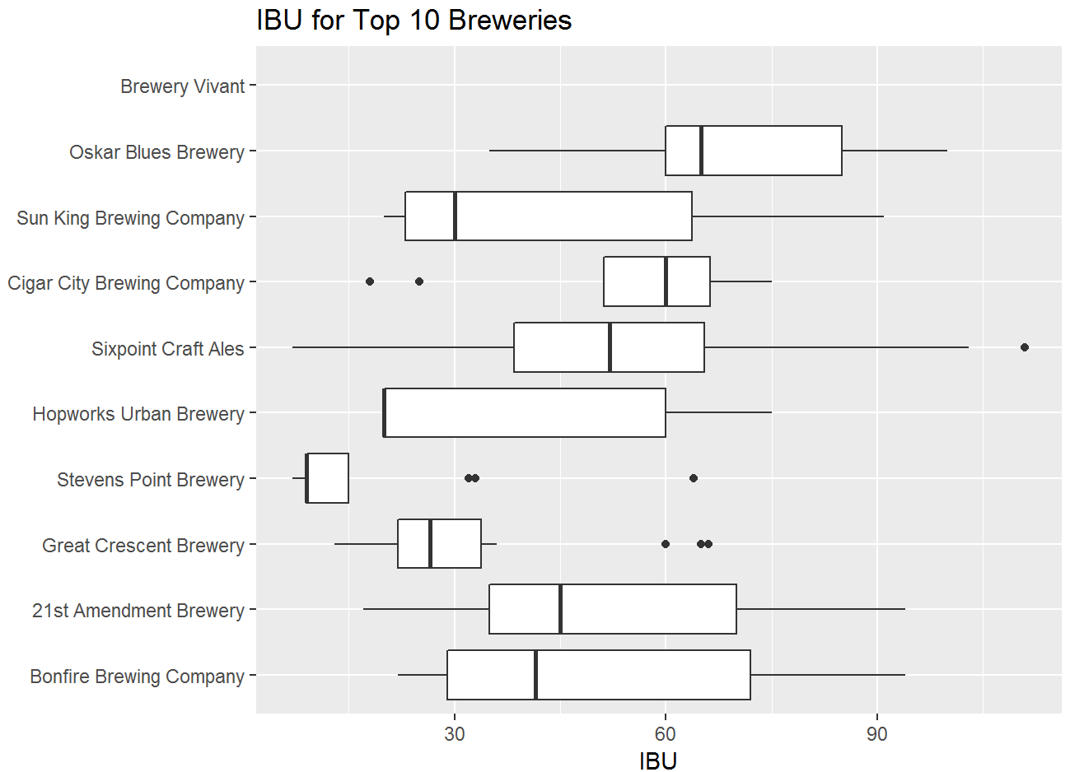
10 Most Popular Breweries abv & ibu
Popularity is determined by the number of beers being produced by each brewery.

Slide 6
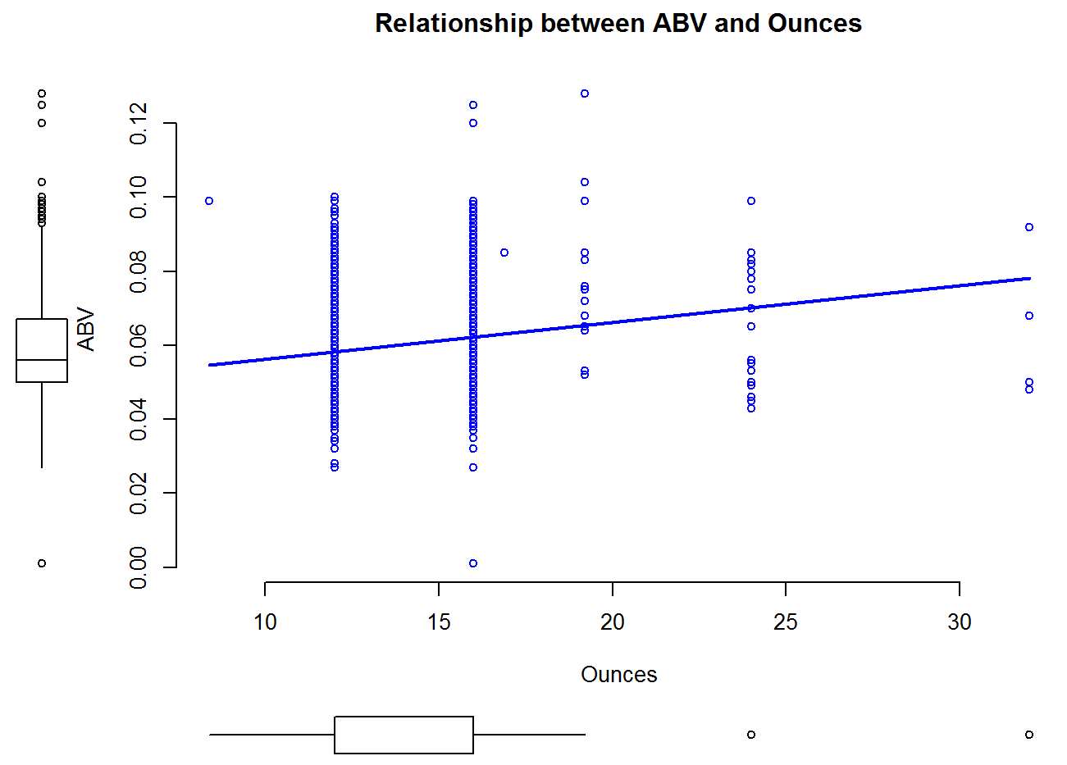
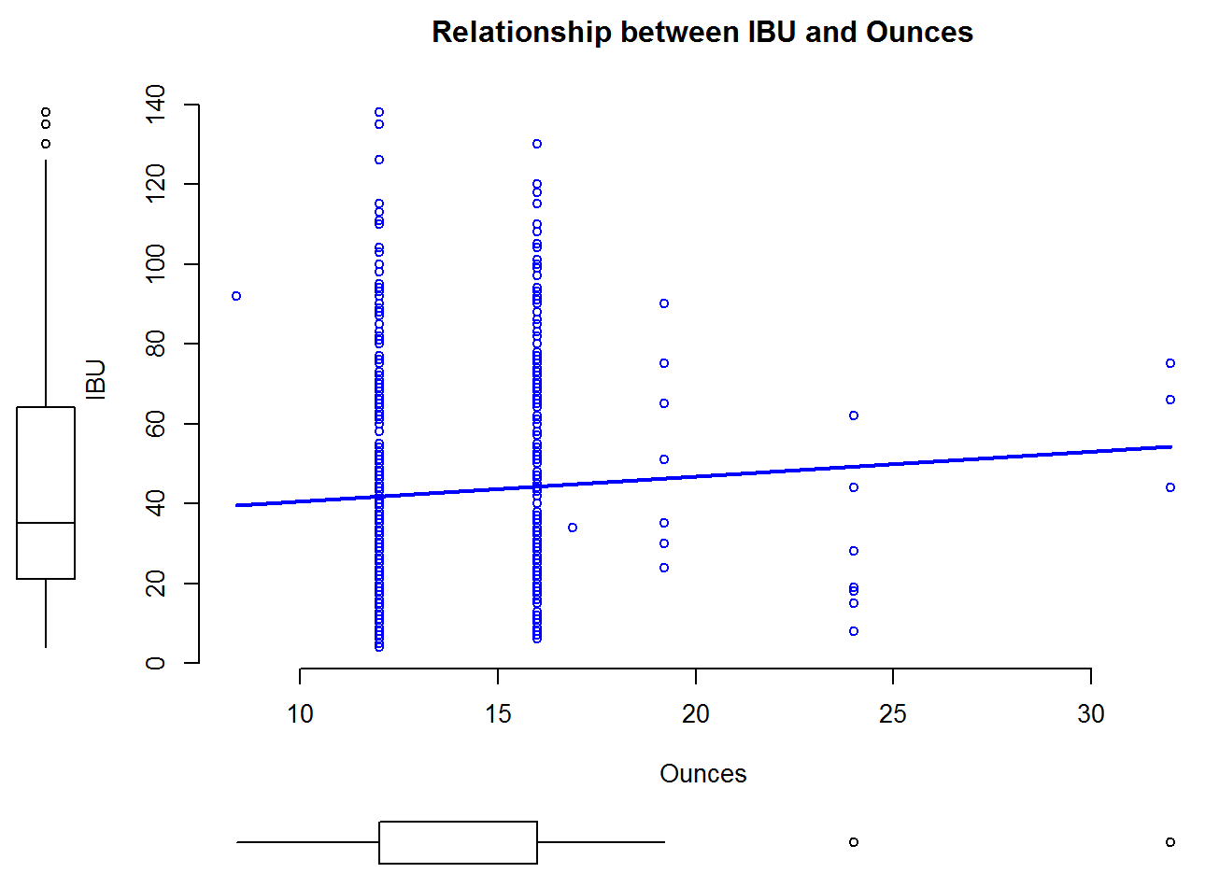
Relationship between Ounces and ABV/ibu

Slide 7
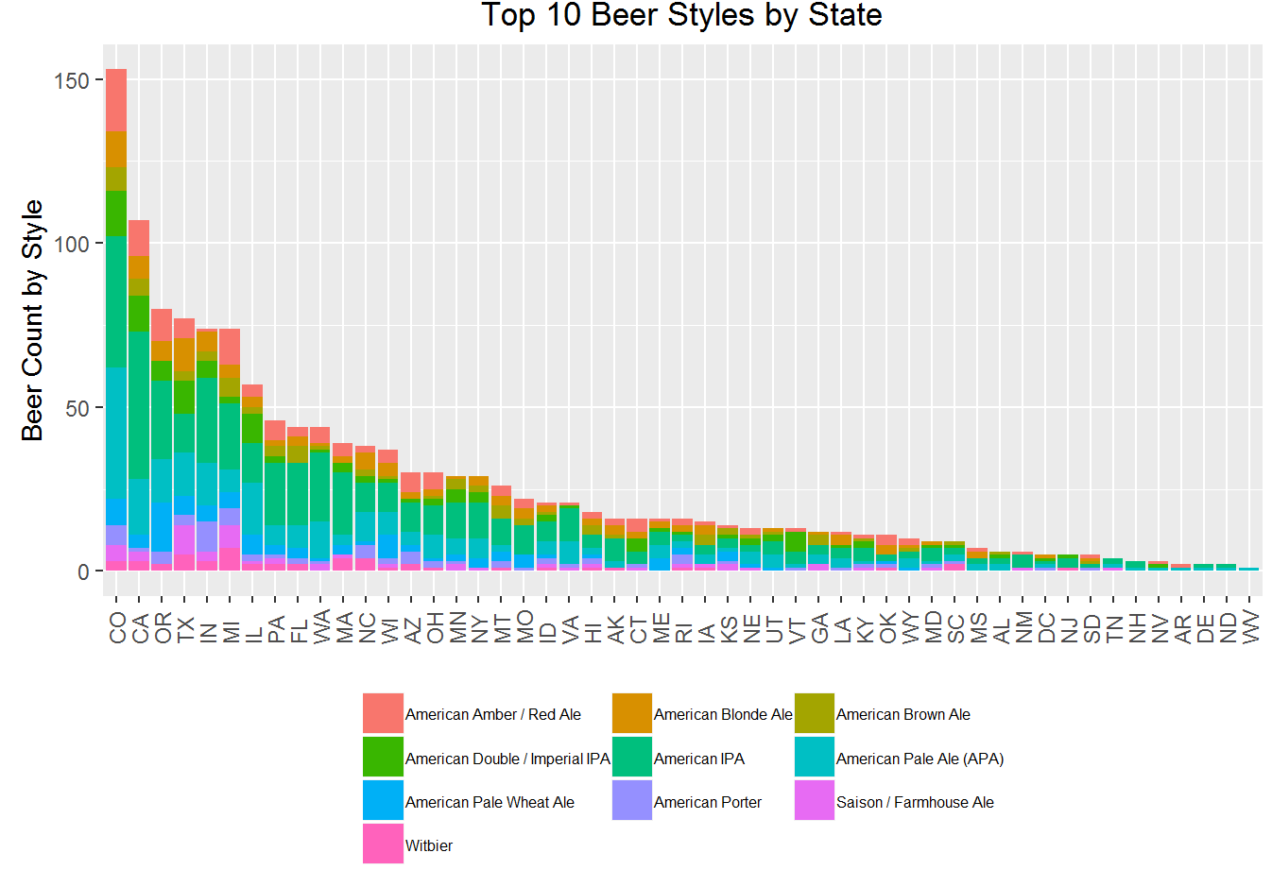
Top 10 beer styles by state

